Slide 1
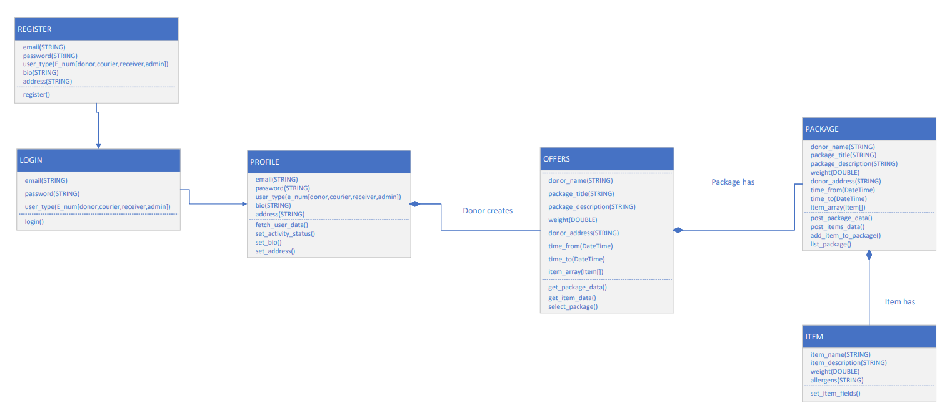
FoodPantry: Class diagram

